Slide 1
Notes:
Hello everyone, and thank you for joining me today. I'm excited to present the kickoff for my internship project, which focuses on a multi-criteria analysis based on the life cycle assessment method for positive energy districts. Today, I'll outline the approach and model I used from last internship to have a better understanding of the relevance between this internship and the last. I'd also like to extend my heartfelt thanks to Professor Herve , Gauthier, Arthur and Nicolas for their invaluable guidance as my supervisors and colleagues.

Slide 2
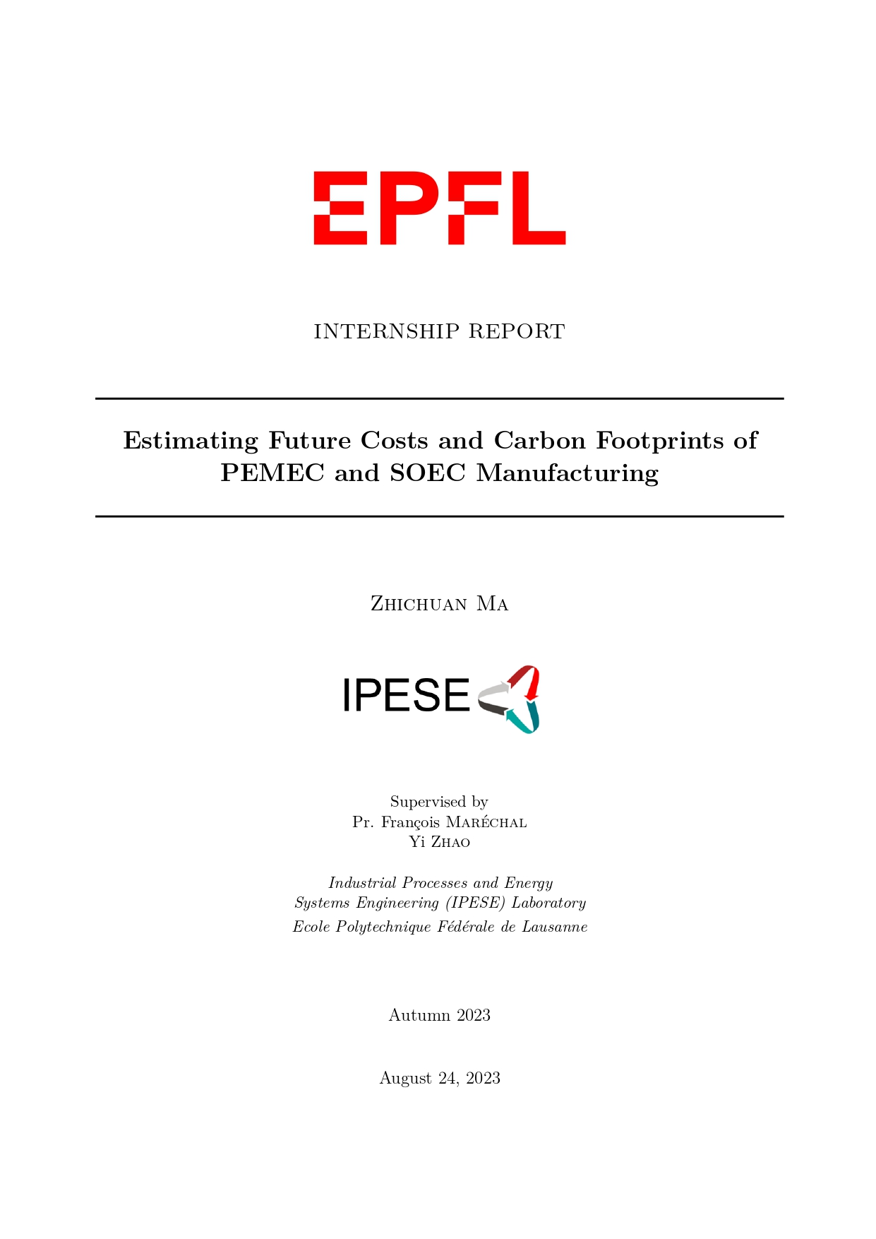
Introduction
Internship in EPFL
Scale-Induced Efficiencies:
As production scale increases, economies of scale come into play.
Technological Progression:
Continuous technological advancement enhances efficiency.
Resource Optimization:
Low-carbon electricity’s use can hugely decrease the carbon dioxide emissions
Lifecycle Analysis:
Optimization opportunities across all stages, from raw materials to disposal.
Sustainability Reporting:
Estimate the future cost as well as environmental impacts, giving instructions to industry.
Notes:
So to begin with, I would like to give a short introduction about my

Slide 3










Introduction
What is LCA
Life cycle assessment (LCA), also known as life cycle analysis, is a methodology for assessing environmental impacts associated with all the stages of the life cycle of a commercial product, process, or service.
Goal & scope
Inventory analysis
Impact assessment
Interpretation
System Boundary
Function Unit
INVENTORY
IMPACTS
TOTAL

Slide 4
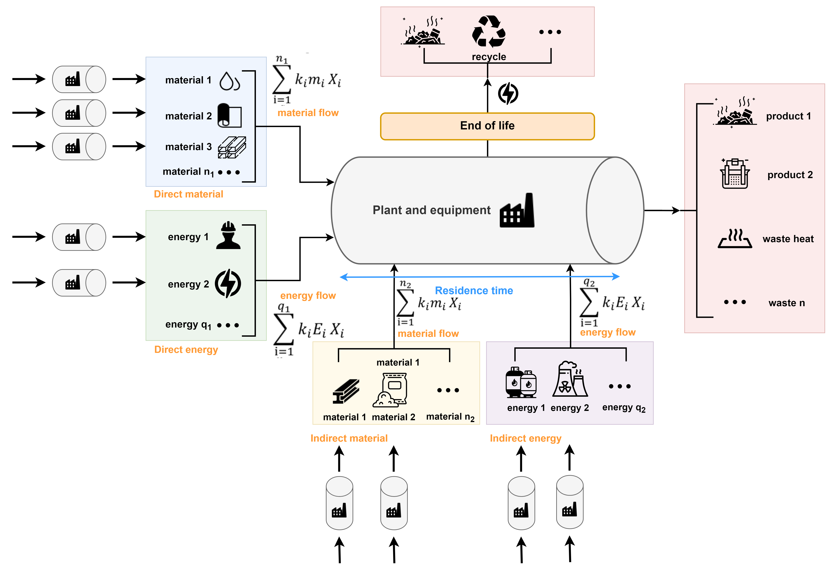
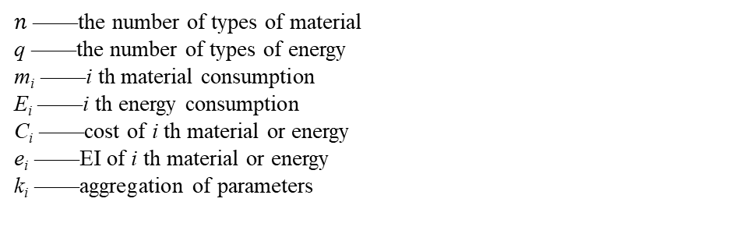
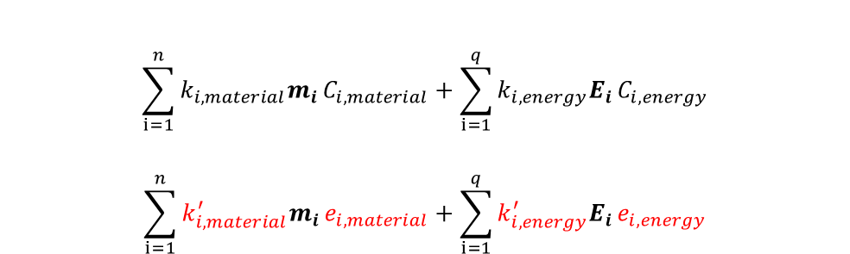
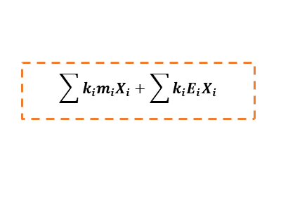
Methodology
General formula
Waste treatment
Direct contribution
Product & waste
Indirect contribution
$$\sum{k_{i}m_{i}X_{i}}+\sum{k_{i}E_{i}X_{i}}$$
Combination of LCA and cost estimation
Application of this model in PEM and SOEC in manufacturing is discussed
$$\sum_{i=1}^{n}{k_{i, material}m_{i}}C_{i, material}+\sum_{i=1}^{q}{k_{i, energy}E_{i}}C_{i, energy}$$
$$\sum_{i=1}^{n}{k_{i, material}^{′}m_{i}}e_{i, material}+\sum_{i=1}^{q}{k_{i, energy}^{′}E_{i}}e_{i, energy}$$
Cost calculation:
$n$ ——the number of types of material
q ——the number of types of energy
m_{i} ——i th material consumption
E_{i} ——i th energy consumption
C_{i} ——cost of i th material or energy
e_{i} ——EI of i th material or energy
k_{i} ——aggregation of parameters
Environmental impacts evaluation:

Slide 5
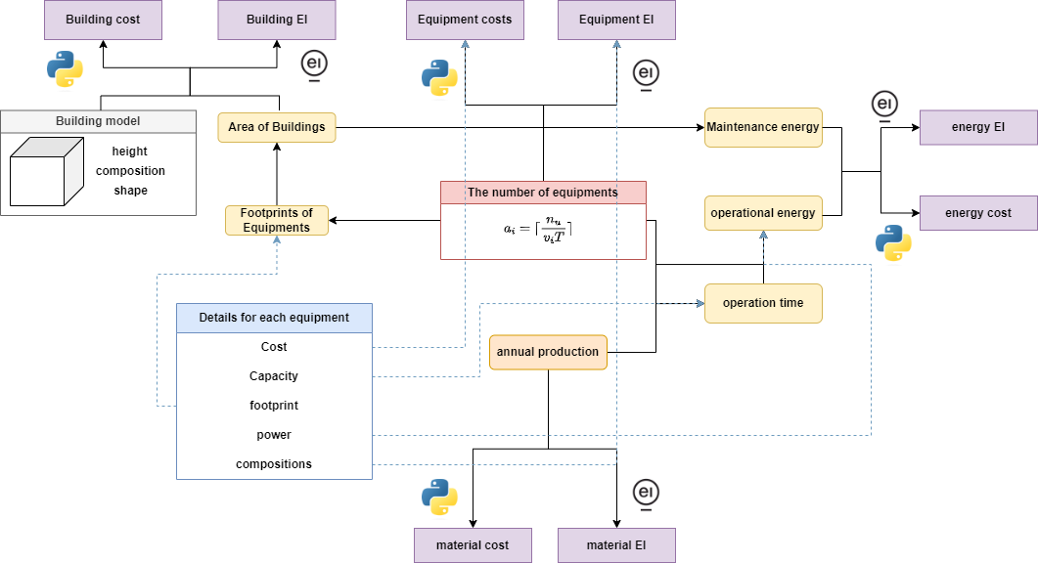
Methodology
Model
Estimation function: F(x)

Slide 6
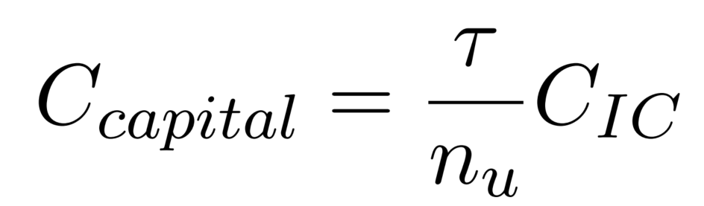
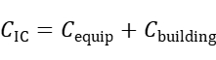
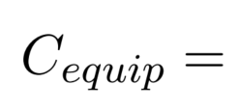
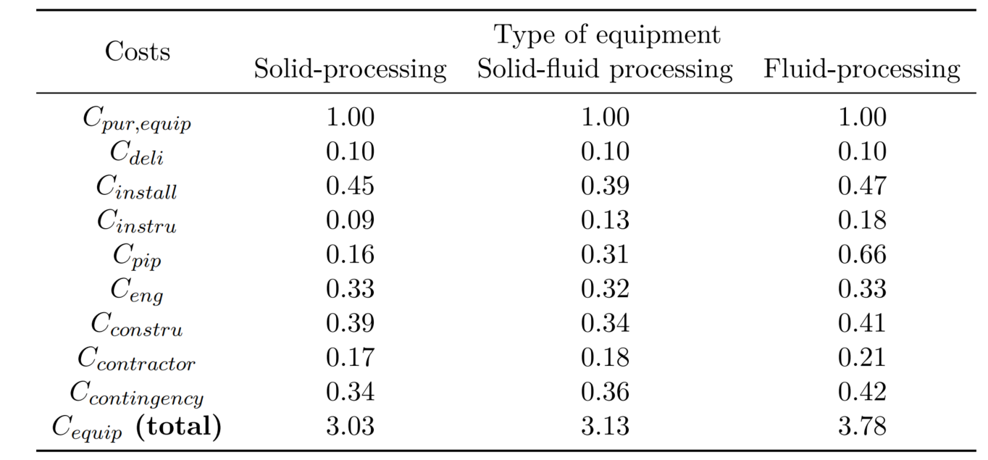
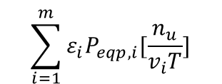
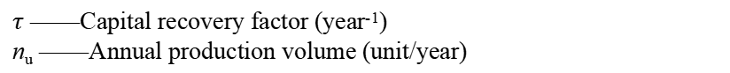
Methodology
Indirect contribution – Equipment cost
($/unit)
Equipment cost
$τ$ ——Capital recovery factor (year⁻¹)
n_{u} ——Annual production volume (unit/year)
1
$$\sum_{i=1}^{m}{ε_{i}P_{eqp,i}[\frac{n_{u}}{v_{i}T}]}$$
P_{eqp,i}——the price of equipment i ($)
v_{i}——the throughput of equipment i (unit/min)
T——the maximum annual operation time (hr/y)
[1] M. S. Peters, K. D. Timmerhaus, and R. E. West, Plant design and economics for chemical engineers. New York: McGraw-Hill Professional, 2002.

Slide 7
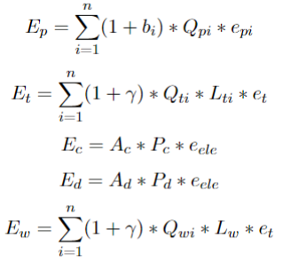
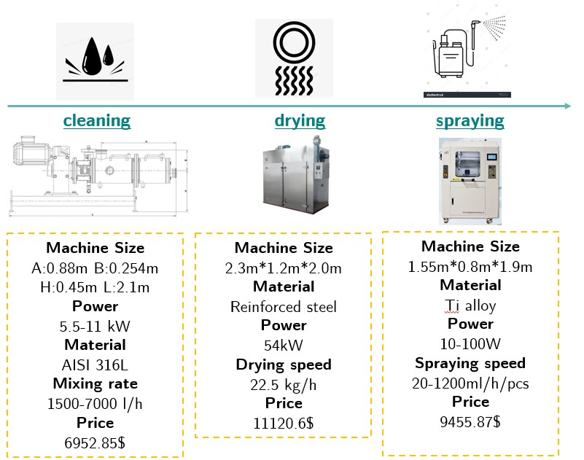
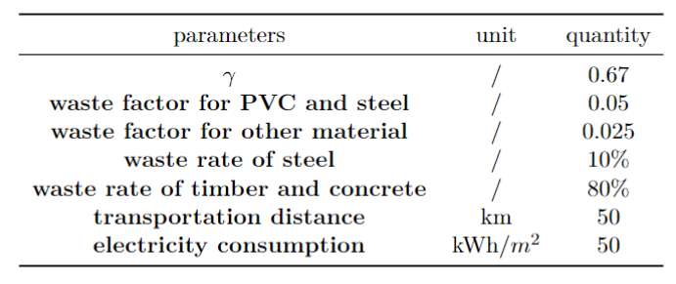
Methodology
Indirect contribution – Equipment environmental impacts
Building Information Modeling (BIM) is introduced for equipment.
1
The material composition
The footprint
The power
Waste rate
Direct contact with manufacturer
Web browsing
Reasonable assumptions
1
[1] Hao et al. Carbon emission reduction in prefabrication construction during materialization stage: A BIM-based life-cycle assessment approach, Science of The Total Environment, Volume 723, 2020

Slide 8
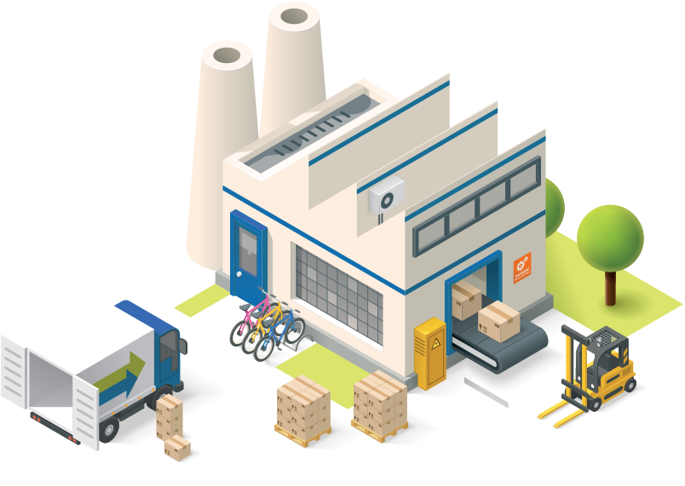
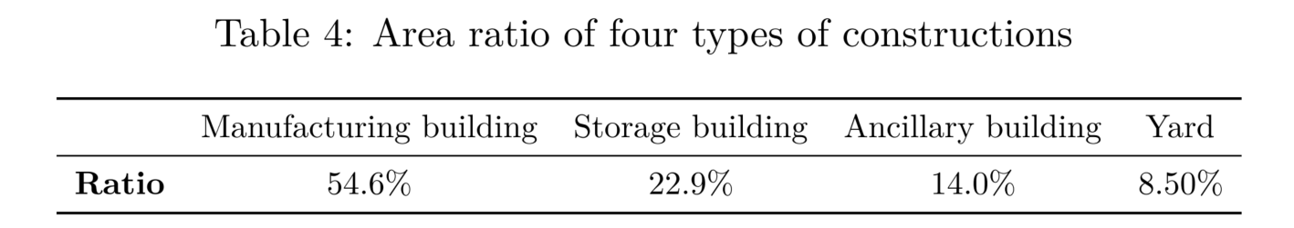
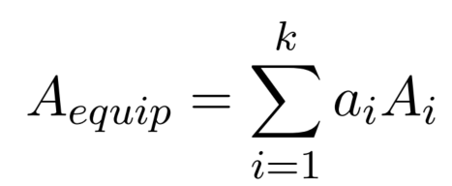
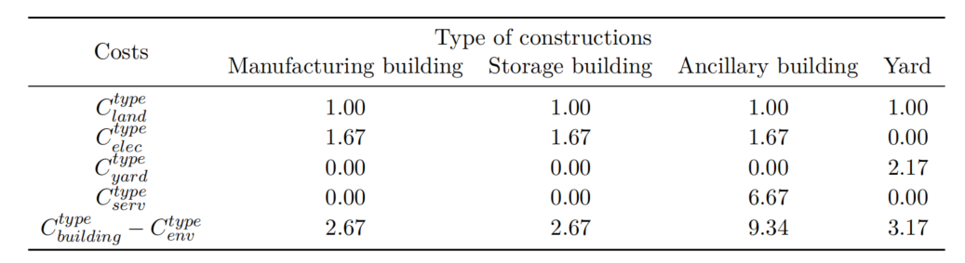
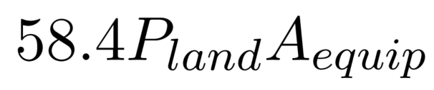

Methodology
Indirect contribution – Building
4 types of constructions
Building cost
1
$$a_{i}=[\frac{n_{u}}{v_{i}T}]$$
[1] M. S. Peters, K. D. Timmerhaus, and R. E. West, Plant design and economics for chemical engineers. New York: McGraw-Hill Professional, 2002.

Slide 9
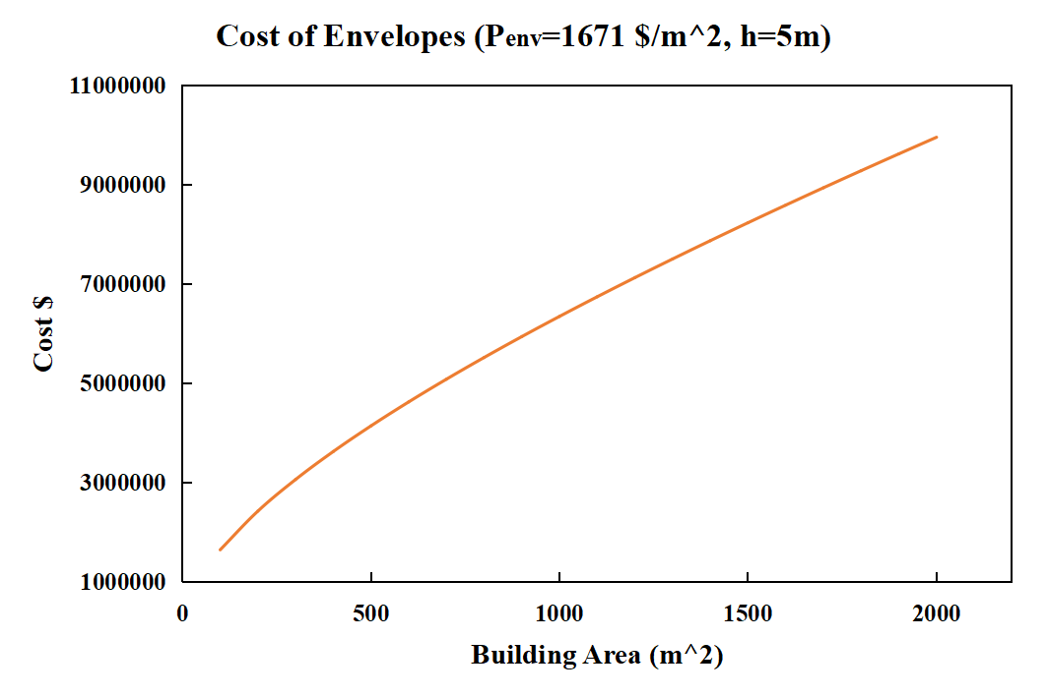
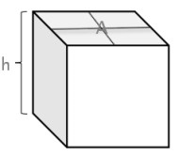
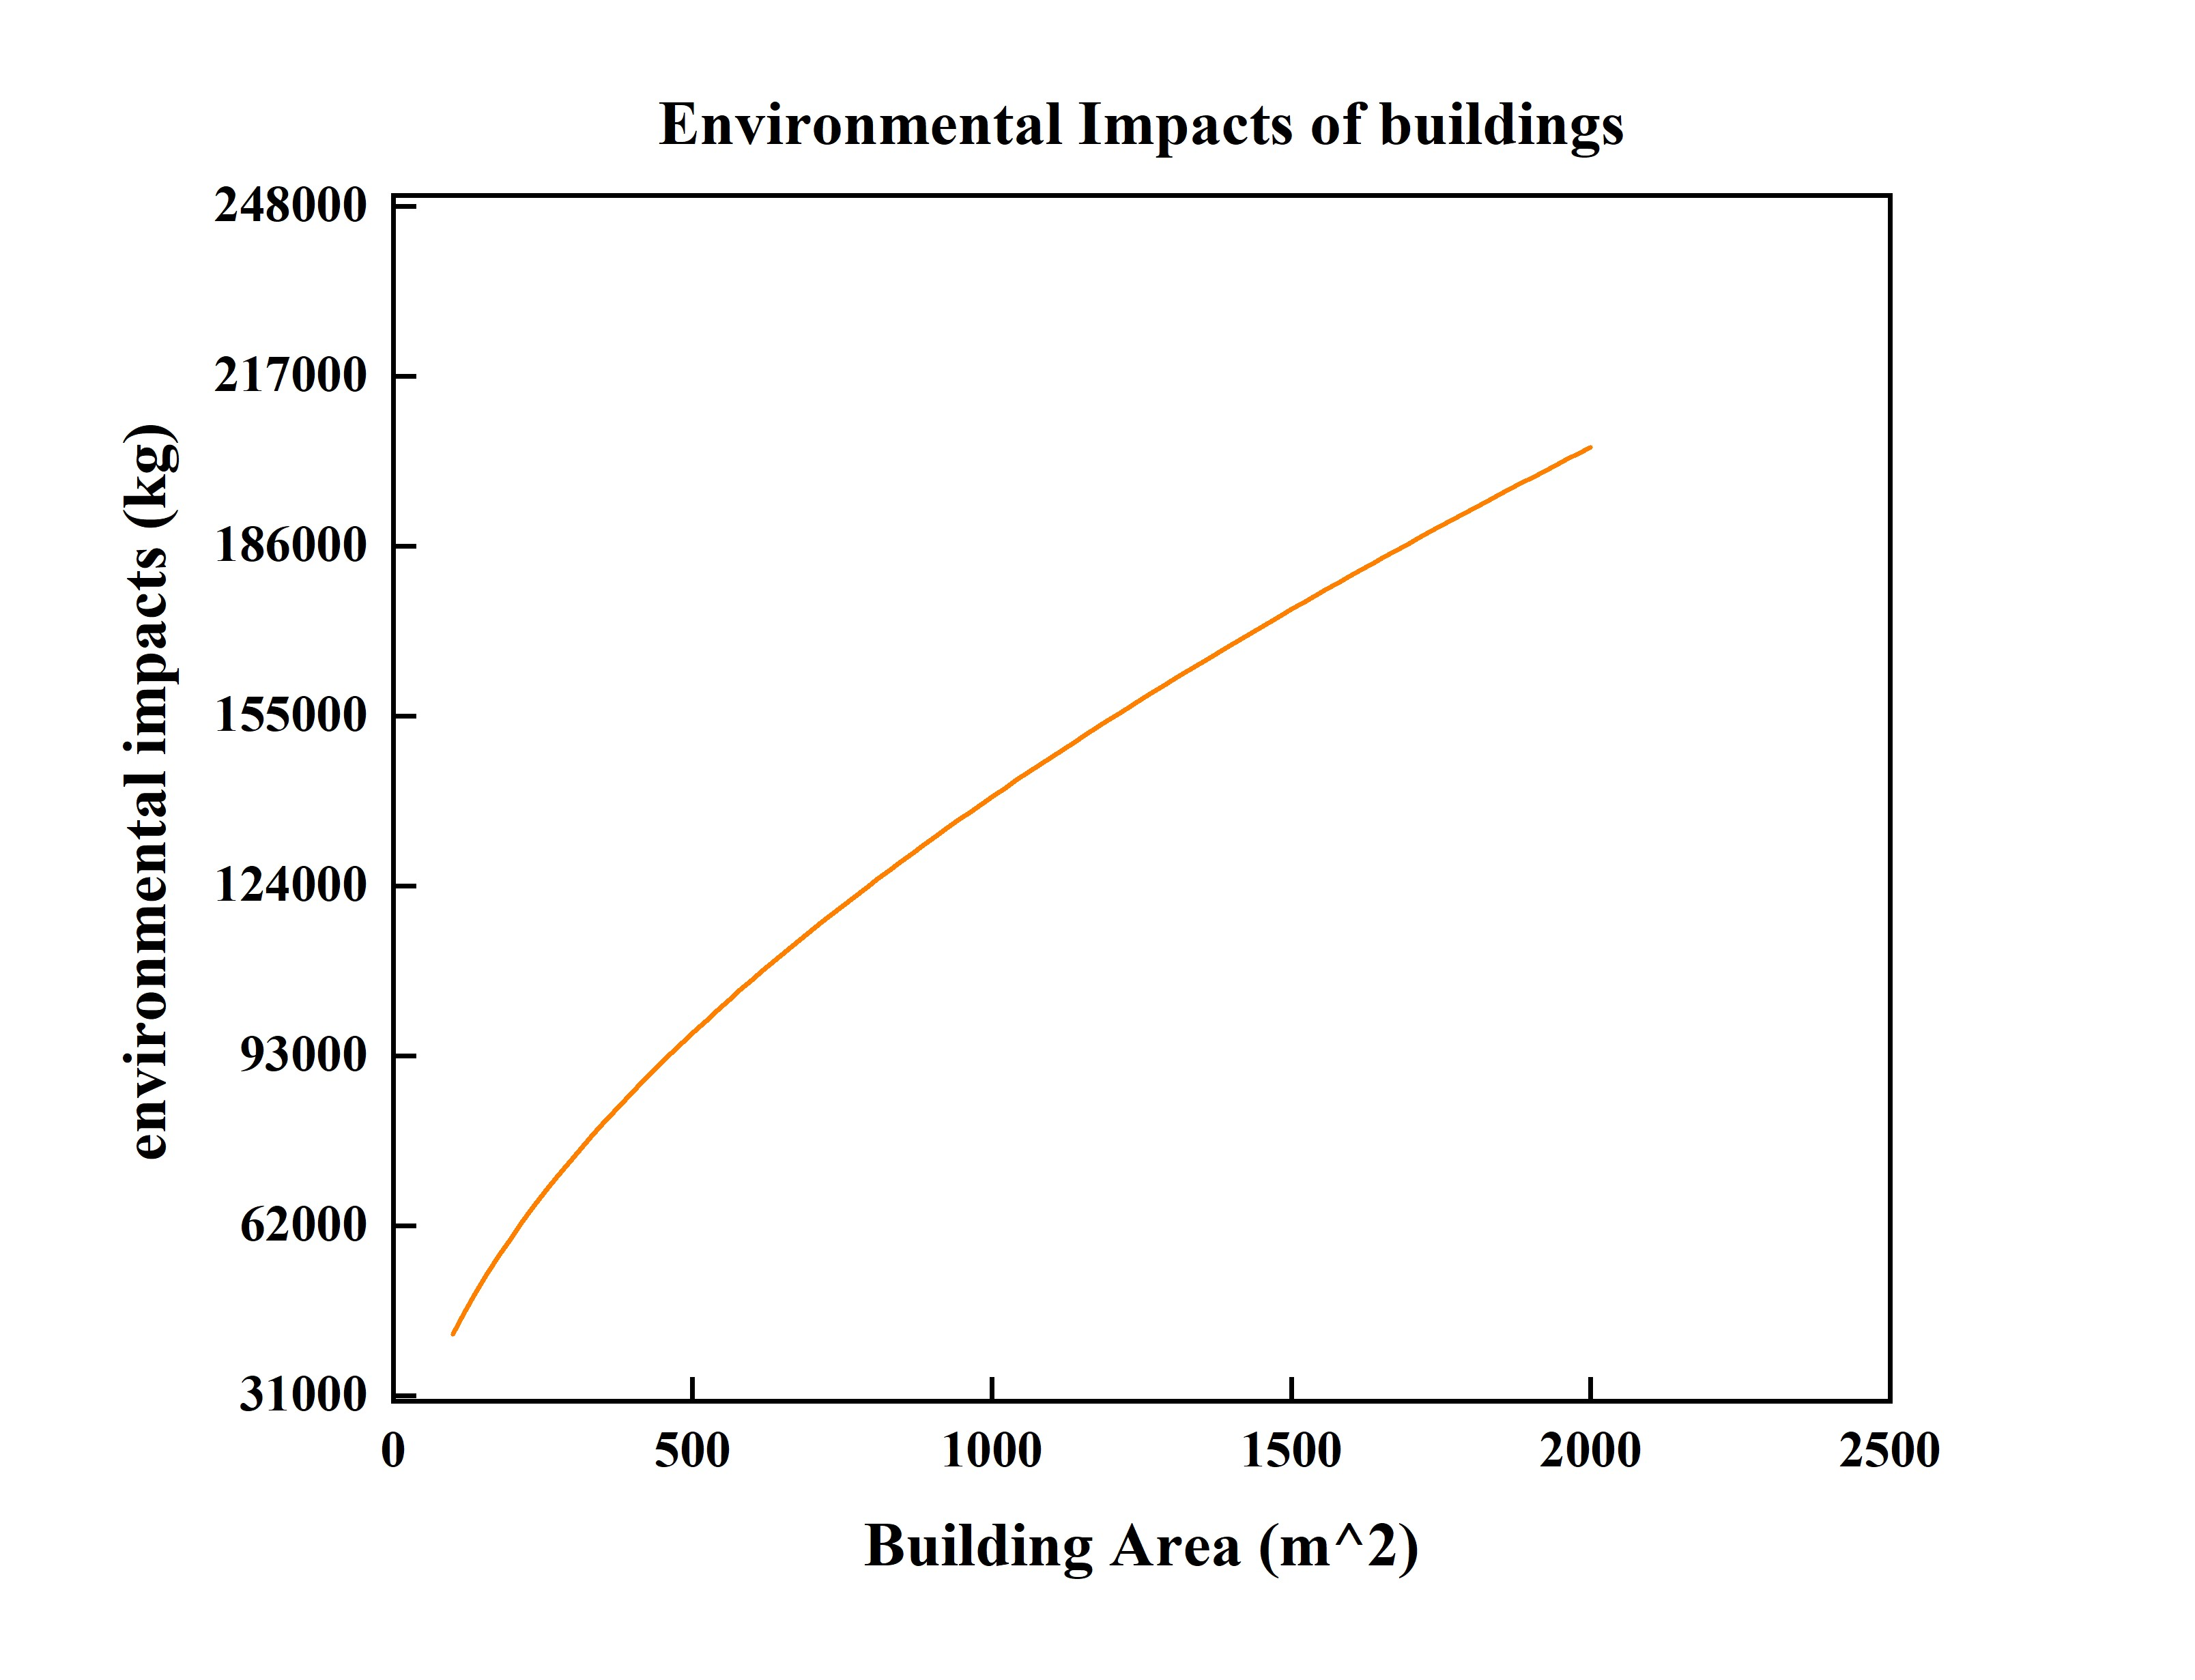
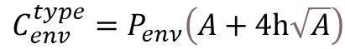
Methodology
Indirect contribution – Building
Building cost
Assume the thickness of the wall is 25cm, h = 5m.
The wall is composed with concrete and steel whose reinforced rate is 1%.
Envelope cost
$$C_{env}^{type}=P_{enν}\left(A+4h\sqrt{A}\right)$$
Similar consideration
$$e_{building}=\frac{8ρ_{mix}h\sqrt{A_{manu}}τe_{mix}}{n_{i}}+A_{manu}P_{main}e_{ele}$$

Slide 10
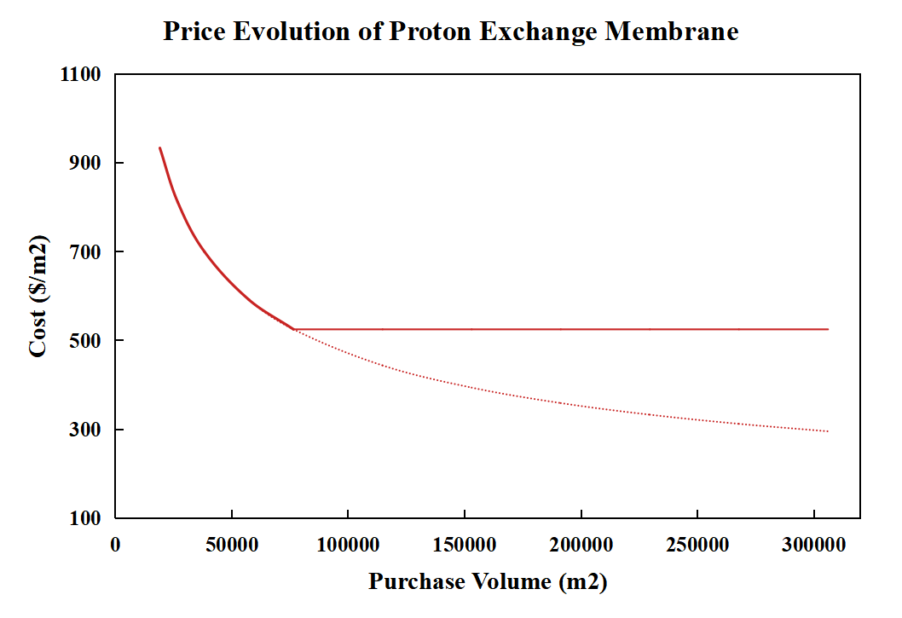
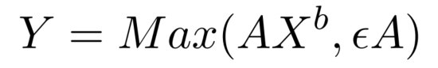
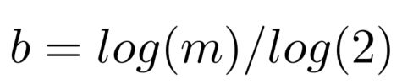
Methodology
Direct contribution – Material cost
[1]
Purchasing volume
Anuual production volume
Materials in R1 are custom-built materials and are only applied in factory f_{j} such as solvents of certain components.
m=0.8
Materials in R2 are those commonly used in certain industries such as the Nafion membranes used in the production of PEM electrolyzers.
m=0.9
Materials in R3 are used all around the world in all kinds of industries such as metal, so that prices are not influenced by a single factory.
m=1
Materials in R4 are rare materials, the reserves of which are small and fixed.
[1] Shengyue Lu, https://infoscience.epfl.ch/record/296756

Slide 11
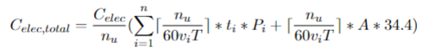
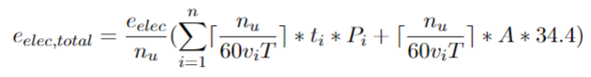
Methodology
Direct contribution – Energy
As for energy, the calculation will be much simpler. The general calculations are displayed as follows, considering the energy is fully composed of electricity.
Manufacturing electricity
Maintenance electricity

Slide 12
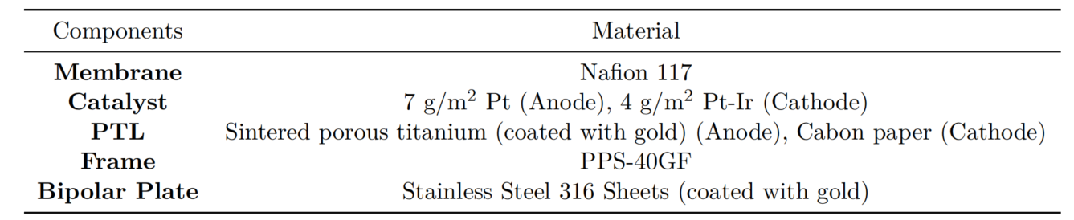
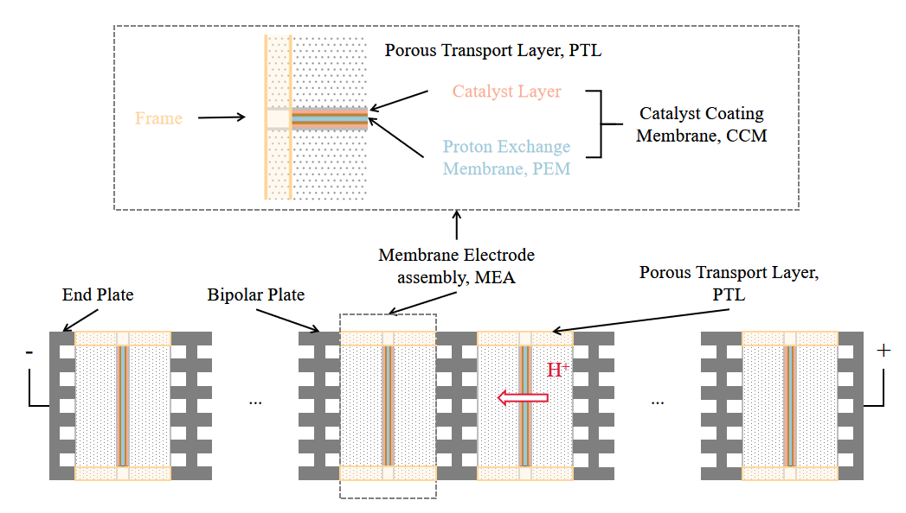
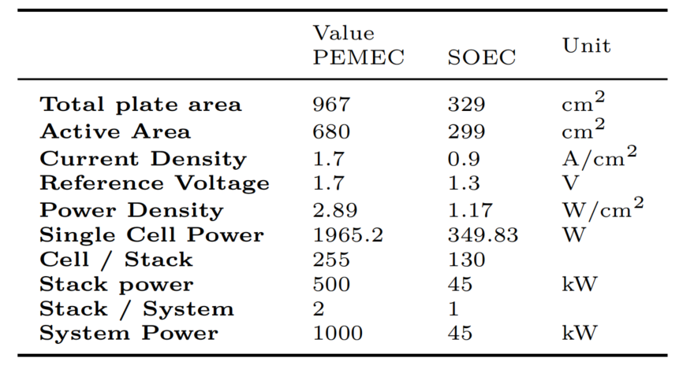
Case study
Specifications of PEMEC
1
PEMEC
2
Functional specification of the PEM electrolysis system and SOEC system
[1] Mayyas, Ahmad T, Mark F Ruth, Bryan S Pivovar, Guido Bender, and Keith B Wipke. “Manufacturing Cost Analysis for Proton Exchange Membrane Water Electrolyzers,” 2019.
[2] Scataglini, R., M. Wei, A. Mayyas, S. H. Chan, T. Lipman, and M. Santarelli, Fuel Cells, 2017.
[3]R. Anghilante, D. Colomar, A. Brisse, and M. Marrony, International Journal of Hydrogen Energy, 2018.

Slide 13
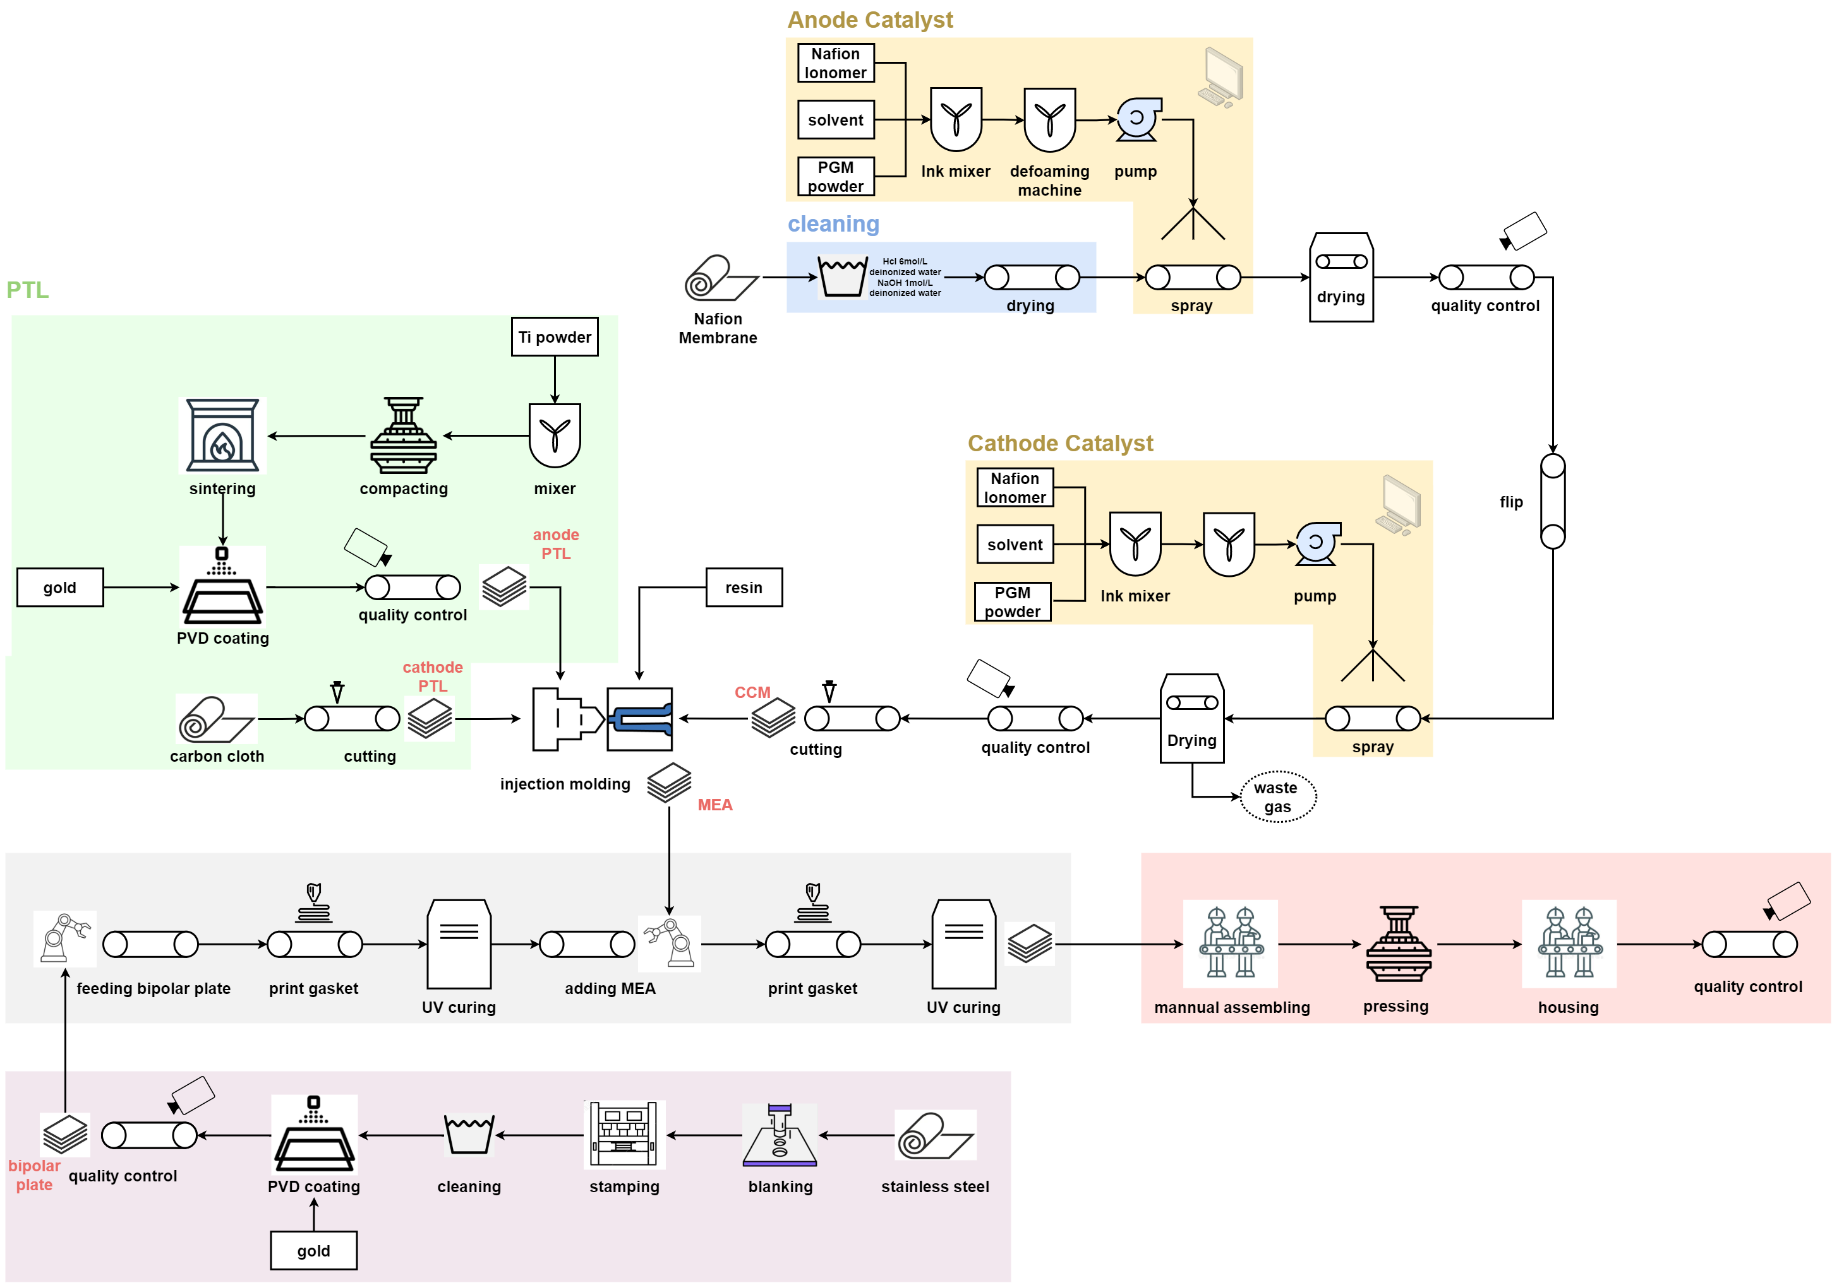
Case study
Production lines of PEMEC
200 kW / 1 MW, 10-50000 unit/y
catalyst coating membrane (CCM)
porous transport layer (PTL)
Frame
Assembly
Bipolar Plate
[1] Mayyas, Ahmad T, Mark F Ruth, Bryan S Pivovar, Guido Bender, and Keith B Wipke. “Manufacturing Cost Analysis for Proton Exchange Membrane Water Electrolyzers,” 2019.

Slide 14
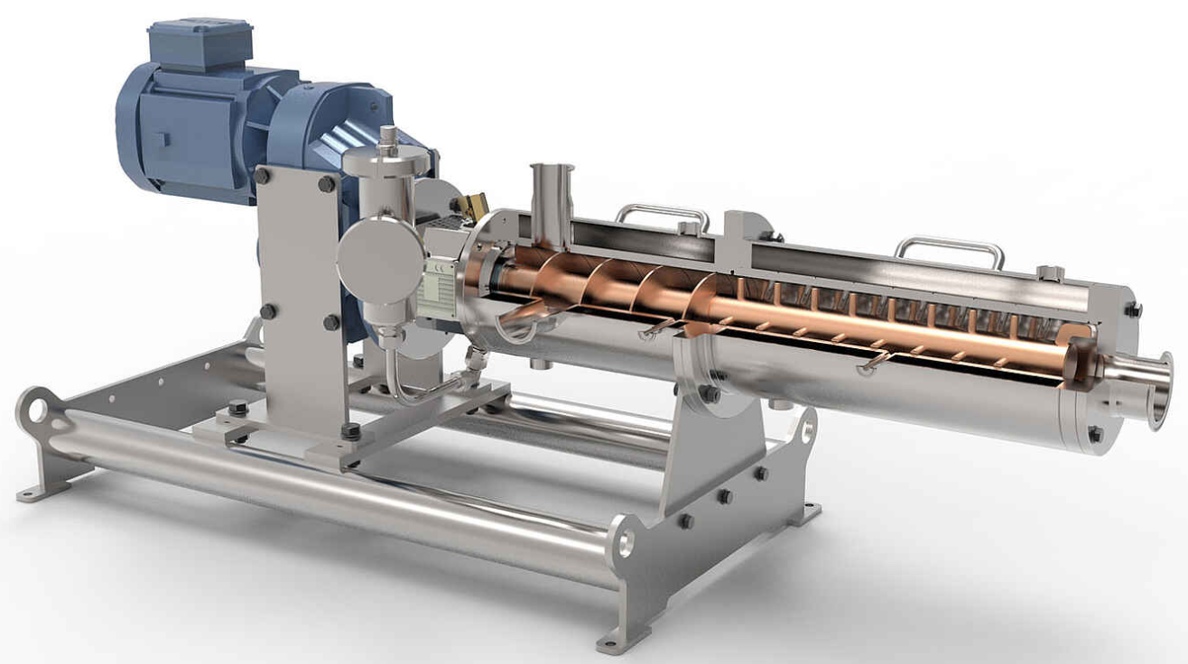
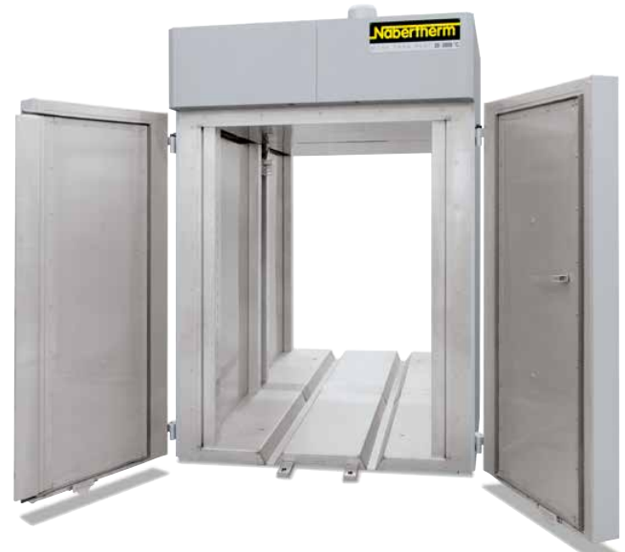
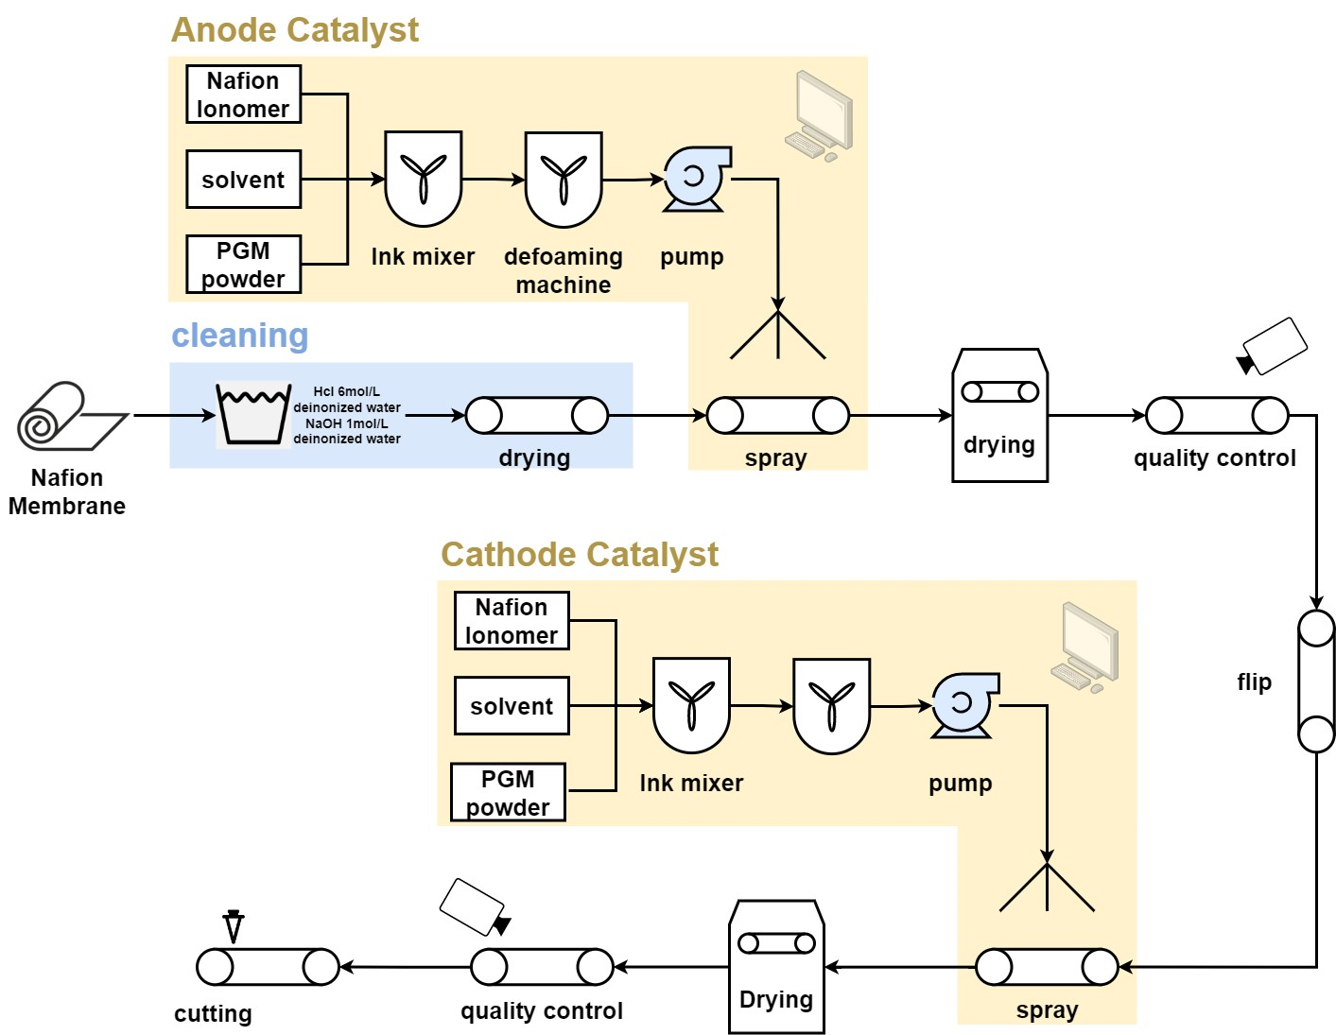
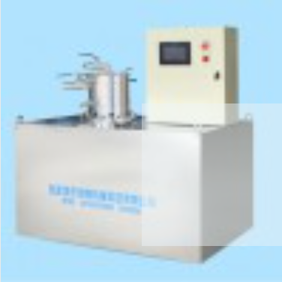
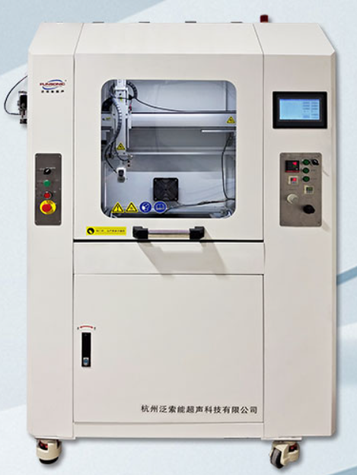
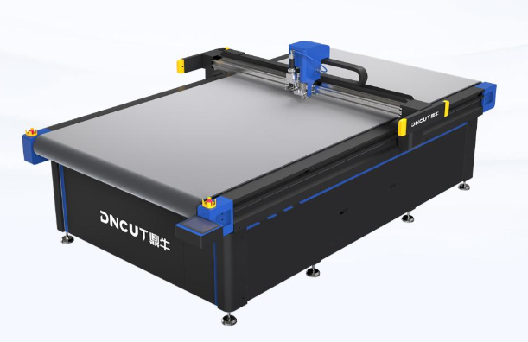
Case study
PEM-CCM
Area: 1.0668 m²
Mixing rate: 7.0 m³/h
Weight: 6206 kg
Power: 8.25 kW
Area: 9.46 m²
drying rate: 22.5 kg/h
Weight: 2400 kg
Power: 9.46 kW
Area: 0.936 m²
Defoaming rate: 1.5 m³/h
Weight: 6206 kg
Power: 25 kW
Area: 1.24 m²
Spraying rate: 0.0288 m³/h
Weight: 650 kg
Power: 25 kW
Area: 4 m²
cutting rate: 518.4 m³/h
Weight: 945 kg
Power: 9 kW

Slide 15
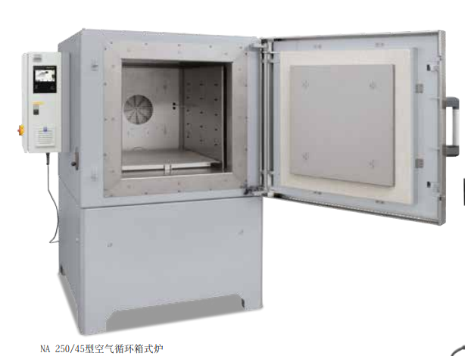
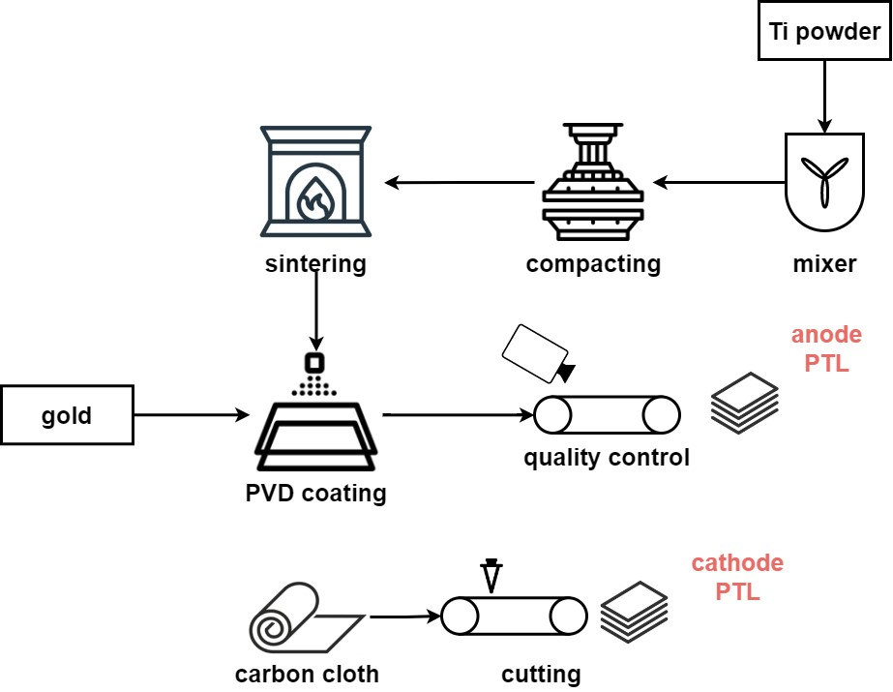
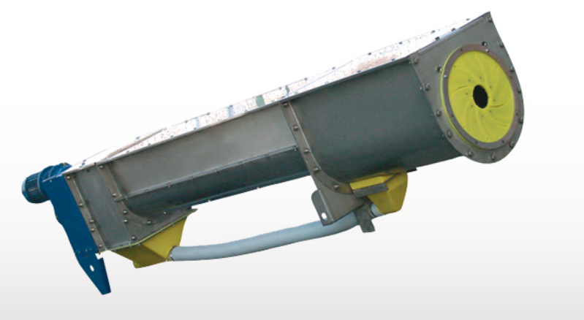
Case study
PEM-PTL
Area: 1.0668 m²
Mixing rate: 7.0 m³/h
Weight: 6206 kg
Power: 8.25 kW
Area: 2.7813 m²
drying rate: 7.0 m³/h
Weight: 314 kg
Power: 6 kW
Area: 6.63 m²
Mixing rate: 8.0 m³/h
Weight: 2500 kg
Power: 4 kW
Area: 1.24 m²
Spraying rate: 0.0288 m³/h
Weight: 650 kg
Power: 25 kW
Area: 4 m²
cutting rate: 518.4 m³/h
Weight: 945 kg
Power: 9 kW

Slide 16
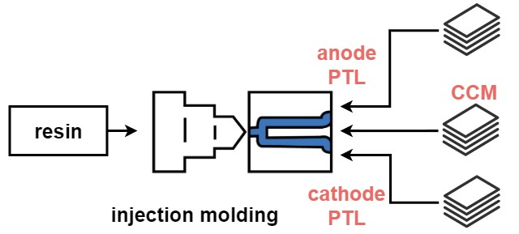
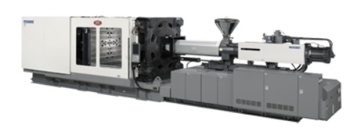
Case study
PEM-injection modeling
Area: 12.2412 m²
cutting rate: 2274.3 m³/h
Weight: 40 kg
Power: 40 kW

Slide 17
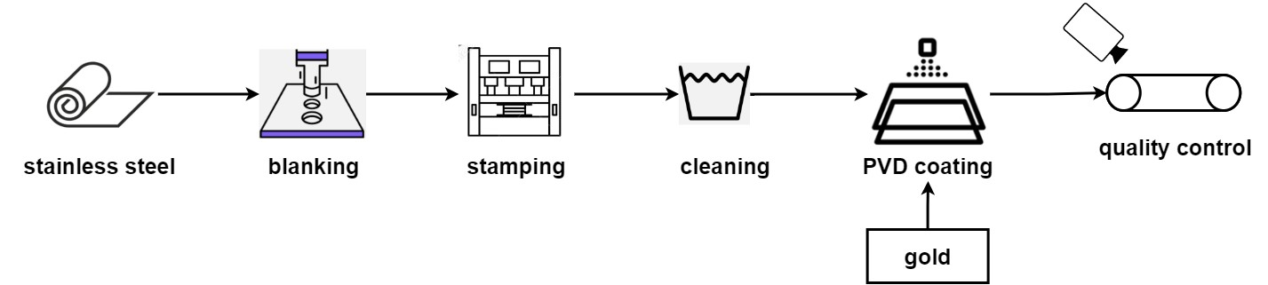
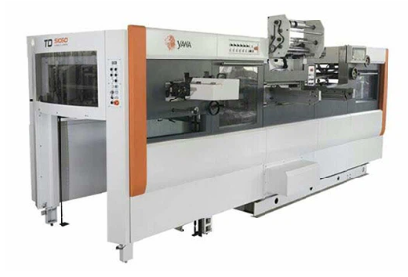
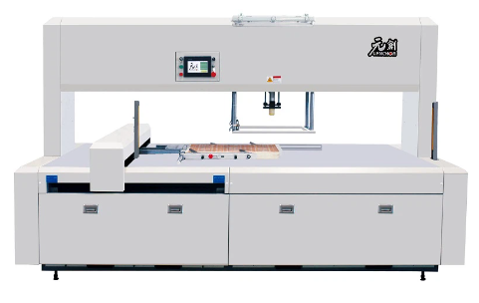
Case study
Bipolar Plate
Area: 7.5425 m²
Blanking rate: 1366.2 m³/h
Weight: 3000 kg
Power: 4.5 kW
Area: 27.18 m²
Mixing rate: 20.4 m³/h
Weight: 18000 kg
Power: 46 kW
Area: 1.0668 m²
Mixing rate: 7.0 m³/h
Weight: 6206 kg
Power: 8.25 kW
Area: 1.24 m²
Spraying rate: 0.0288 m³/h
Weight: 650 kg
Power: 25 kW

Slide 18
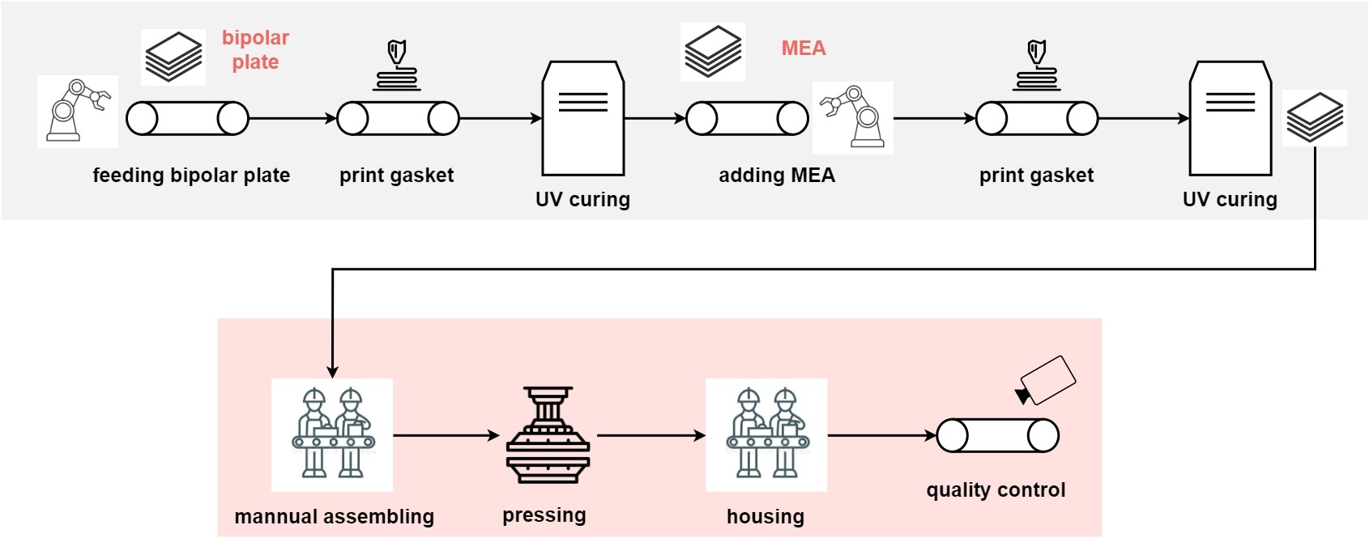
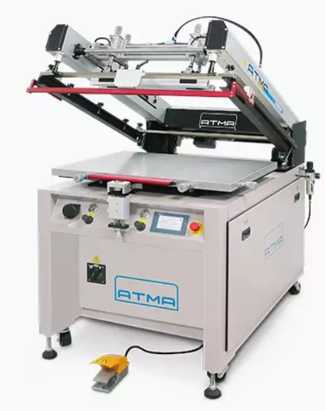
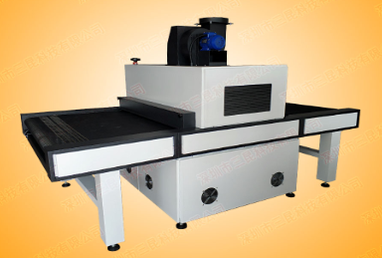
Case study
PEM assembly
Area: 1.7696 m²
cutting rate: 8.6 m³/h
Weight: 660 kg
Power: 2.75 kW
Area: 5.152 m²
cutting rate: 126 m³/h
Weight: 300 kg
Power: 16 kW

Slide 19

SOEC
Production lines of SOEC
200 kW / 1 MW, 10-50000 unit/y
electrolyte and electrode assembly (EEA)
Glass Seal
Assembly
Interconnect
[1] Scataglini, R., M. Wei, A. Mayyas, S. H. Chan, T. Lipman, and M. Santarelli, Fuel Cells, 2017.

Slide 20


Case study
Specifications of SOEC
2
Functional specification of the PEM electrolysis system and SOEC system
SOEC
[1] Mayyas, Ahmad T, Mark F Ruth, Bryan S Pivovar, Guido Bender, and Keith B Wipke. “Manufacturing Cost Analysis for Proton Exchange Membrane Water Electrolyzers,” 2019.
[2] Scataglini, R., M. Wei, A. Mayyas, S. H. Chan, T. Lipman, and M. Santarelli, Fuel Cells, 2017.
[3]R. Anghilante, D. Colomar, A. Brisse, and M. Marrony, International Journal of Hydrogen Energy, 2018.

Slide 21



Case study
Electrolyte and Electrode Assembly (EEA)
Area: 1.0668 m²
Mixing rate: 7.0 m³/h
Weight: 6206 kg
Power: 8.25 kW
Area: 0.4264 m²
Milling rate: 0.018 m³/h
Weight: 110 kg
Power: 2.8 kW
Area: 0.189 m²
casting rate: 4000 kg/h
Weight: 329.8 kg
Power: 18.5 kW
Area: 5.152 m²
cutting rate: 126 m³/h
Weight: 300 kg
Power: 16 kW
Area: 9.46 m²
drying rate: 22.5 kg/h
Weight: 2400 kg
Power: 9.46 kW

Slide 22

Case study
Glass Seal
Area: 12.2412 m²
cutting rate: 2274.3 m³/h
Weight: 40 kg
Power: 40 kW
Area: 2.7813 m²
Mixing rate: 7.0 m³/h
Weight: 314 kg
Power: 6 kW

Slide 23

Case study
Interconnect
Area: 27.18 m²
Mixing rate: 20.4 m³/h
Weight: 18000 kg
Power: 46 kW
Area: 1.0668 m²
Mixing rate: 7.0 m³/h
Weight: 6206 kg
Power: 8.25 kW
Area: 1.24 m²
Spraying rate: 0.0288 m³/h
Weight: 650 kg
Power: 25 kW

Slide 24

Case study
SOEC Assembly
Area: 6.63 m²
Mixing rate: 8.0 m³/h
Weight: 2500 kg
Power: 4 kW

Slide 25

Results
Cost evolutions of PEMEC and SOEC manufacturing
Cost evolutions of PEMEC and SOEC
(shaded area represents the deviation of the material prices)
Volume < 500 MW/y
The costs decreses extrmely fast and an exponential correlation between the cost and volume is almost fulfilled.
500 < Volume < 10000 MW/y
The costs decrease slower as some of the material prices reach the minimum values. Reductions in capital and labor costs dominate the decline of total costs.
Volume >10000 MW/y
The cost of SOEC is nearly constant, approaching the minimum marginal cost.
1,2,3,4,5
A
B
C
[1] Mayyas, Ahmad T, Mark F Ruth, Bryan S Pivovar, Guido Bender, and Keith B Wipke. “Manufacturing Cost Analysis for Proton Exchange Membrane Water Electrolyzers,” 2019.
[2] Scataglini, R., M. Wei, A. Mayyas, S. H. Chan, T. Lipman, and M. Santarelli, Fuel Cells, 2017.
[3] R. Anghilante, D. Colomar, A. Brisse, and M. Marrony, International Journal of Hydrogen Energy, 2018.
[4] “Manufacturing Cost Analysis of 100 and 250 KW Fuel Cell Systems for Primary Power and Combined Heat and Power Applications.” Battelle Memorial Institute, 2016.
[5] Mýrdal, Jón Steinar Garðarrson, Peter Vang Hendriksen, Christopher Graves, Søren Højgaard Jensen, and Eva Ravn Nielsen. “Predicting the Price of Solid Oxide Electrolysers (SOECs),” 2016.

Slide 26



Results
PEM
The material cost of CCM occupies over 32%. Reducing the use of noble metal in catalyst is the most efficient way to cut down the total cost.
For assembly and frame processes, equipment costs most. New techniques should be introduced. There is little need to invest much on improving them at this stage as the costs of these two components are negligible.

Slide 27



Results
SOEC
The equipment cost and plant cost are the dominant factors.
In all scenarios, new techniques or new production lines should be introduced to increase the use of equipment's and plants.

Slide 28

Results
Environmental impacts (PEM)
As depicted in the figures, in PEMEC, materials are the main source of most environmental impacts.
Among all the materials, the use of platinum, iridium, and gold is the dominant contributor in most of environmental impacts.

Slide 29

Results
Environmental impacts (SOEC)
As depicted in the figures, in SOEC, utilities are the main source of most environmental impacts.
Among all the environmental impacts, the production of SOEC will have larger environmental impacts on freshwater.

Slide 30
Discussion
Estimation of Future Scenarios
Equipped with estimated statistics for future PEM capacity:
Cost estimation
EI estimation
Estimated statistics source: https://www.iea.org/energy-system/low-emission-fuels/electrolysers

Slide 31
Discussion
Estimation of Future Scenarios
Equipped with estimated statistics for future SOEC capacity:
Cost estimation
EI estimation
Estimated statistics source: https://www.iea.org/energy-system/low-emission-fuels/electrolysers

Slide 32
Conclusion
Takeaway messages
Scale-Induced Efficiencies:
As production scale increases, economies of scale come into play.
Improved operational efficiency, resource utilization, and reduced emissions intensity.
Example: Larger hydrogen production facilities reduce environmental impact per unit of output.
Technological Progression:
Continuous technological advancement enhances efficiency.
Research and development efforts lead to reduced environmental footprints.
Resource Optimization:
Larger-scale production facilities implement advanced resource management practices.
Includes energy-efficient equipment, systematic material recycling, and waste reduction.
Low-carbon electricity’s use can hugely decrease the carbon dioxide emissions
Lifecycle Analysis:
Holistic evaluation of product or process lifecycle.
Optimization opportunities across all stages, from raw materials to disposal.
Cumulative reduction in environmental impacts.
Sustainability Reporting:
Larger production scale necessitates more comprehensive sustainability reporting.
Companies respond to stakeholder expectations and evolving regulations.
Estimate the future cost as well as environmental impacts, giving instructions to industry.

Slide 33

This internship
What is “Positive Energy District”?
Enhance the efficiency and robustness
PED
How to invest?
How to operate?
How to evaluate?
RES
REHO
Sector coupling
Cross-vector integration
Storage
Demand flexibility
refine and implement an existing model, enhancing the integration of LCA frameworks and cost
Consumer engagement
E/WH

Slide 34


This internship
General introduction to my last internship
Based on IPESE previous work
The goal of that research was to define the scale effects on the cost and environmental impacts of future technologies in different locations
The scale effects was broken down to several levels, including the production line components
A detailed comprehensive analysis of the PEM & SOEC production line possibilities was conducted
[1] Shengyue Lu, https://infoscience.epfl.ch/record/296756

Slide 35












This internship
The relationship
Investment allocation & process integration (Technology database)
Investment
Cost analysis
Operation strategy & system optimization (MILP)
Performance metrics
$$\sum_{i=1}^{n}{k_{i, material}m_{i}}C_{i, material}+\sum_{i=1}^{q}{k_{i, energy}E_{i}}C_{i, energy}$$
$$\sum_{i=1}^{n}{k_{i, material}^{′}m_{i}}e_{i, material}+\sum_{i=1}^{q}{k_{i, energy}^{′}E_{i}}e_{i, energy}$$
Cost calculation:
Environmental impacts evaluation:

Slide 36
This internship
What I would like to achieve
Life Cycle Assessment (LCA) will be added to provided a more comprehensive methodology.
On the basis of REHO
Disentangle the EoS from the learning effect.
Study the priciples behind the EoS.
Offer suggestions on manufacturing.
Integrate a lifecycle assessment framework into REHO
Implement the model in pilots’ sites by doing case studies
Lack of evaluation of environmental aspects
The combination of cost optimization and LCA can:
Improve the accuracy of optimization model and understanding of methodology
Nuances the benefits of PED with additional LCA based indicator to favorize their deployment

Slide 39

Appendix
Environmental impacts
Environmental impacts evolution of PEMEC and SOEC with annual production volume
Volume < 100 MW/y
The environmental impacts decreases extremely fast
100 < Volume < 1000 MW/y
The costs decrease slower as some of the material carbon footprints reach the minimum values.
Volume >1000 MW/y
The environmental impacts of SOEC is nearly constant, approaching the minimum marginal environmental impact.
A
B
C
Notably, the carbon footprint exhibits a distinct pattern characterized by a steep initial decline followed by a subsequent flattening.

Slide 40

Appendix
Direct contribution – Material environmental impacts
As for environment impacts, materials are also divided into several categories depending on its scarcity.
Nafion synthesis is viewed as the following three formulas with the sulfonation reaction
$${CH}_{4}+3{Cl}_{2}−→{CHCl}_{3}+3HCl$$
$${CHCl}_{3}+2HF−→CHClF_{2}+2HCl$$
$$2CHClF_{2}−→C_{2}F_{4}+2HCl$$
Different equipments are searched online.
Similarly, the carbon footprint of Nafion is the same as the cost evolution trend.
As the output increases, the carbon footprint also decreases and tends to a constant value.
Environmental impacts of direct material’s scale effect

Slide 41


Appendix
Different locations

Slide 42




Appendix
Comparison between n_u = 10unit/year, 100 units/year and 1000 units/year from GWP perspective
In Switzerland the carbon footprint of electricity is about 0.17 kg CO2e per kWh of electricity
Wind
Finland
Canada
Denmark
Austria
Italy
France
Global 2030
Germany
4.5
Sweden
Global 2050
Switzerland
$$n_{u}=10$$
United
Kingdom
iceland
Slovenia
4.4
Scale-up effect
Norway
Photovoltaic
$$n_{u}=100$$
carbon footprint for different n_u per year per MW(kg)
4.3
$$n_{u}=1000$$
4.2
4.1
0
0.05
0.10
0.15
0.20
0.25
0.30
0.35
0.40
0.45
0.50
0.55
0.60
Carbon footprint of electricity (kg CO₂e per kW h of electricity)
The carbon footprint for the electrolyzer production depends linearly on the carbon footprint of electricity supply
Obviously, the relationship between carbon footprint per 1 MW production and annual production is non-linear.
[1] Deutz, S., Bardow, A. Life-cycle assessment of an industrial direct air capture process based on temperature–vacuum swing adsorption, 2021

Slide 43



Appendix
Some other figures

Slide 44

Appendix
Predictions

Slide 45

Methodology
General formula

Slide 46

Roadmap
What I am going to do?

